Slide 1
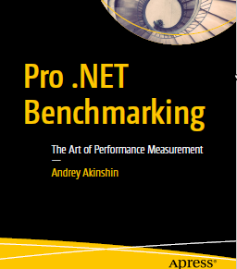
Pro .NET Benchmarking

Slide 2

WHY
https://www.youtube.com/watch?v=sahSAMj8OIY

Slide 3

Author

Slide 4
Links
Book
https://www.apress.com/gp/book/9781484249406
Source Code
https://github.com/Apress/pro-.net-benchmarking
BenchmarkDotNet
https://github.com/dotnet/BenchmarkDotNet
Rstudio
https://www.rstudio.com/
R
https://cran.r-project.org/bin/windows/base/

Slide 5
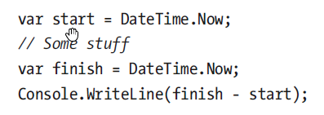
First Benchmark

Slide 6
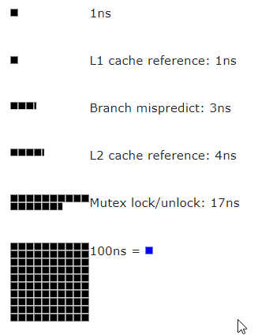
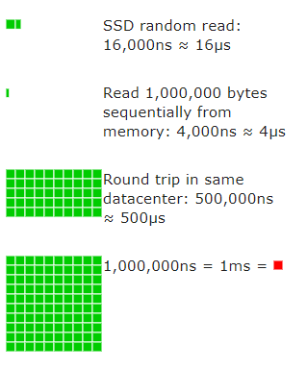
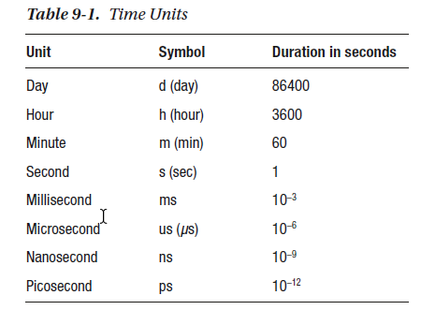
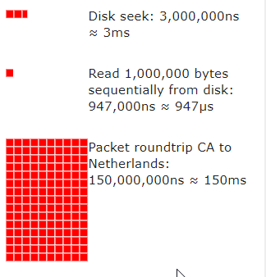
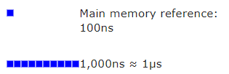
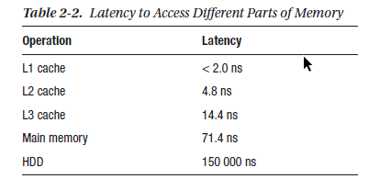
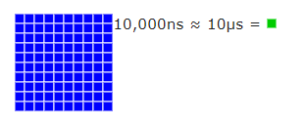
Time units
https://people.eecs.berkeley.edu/~rcs/research/interactive_latency.html
A picosecond relates to a second as a second relates to 31710 years!

Slide 7
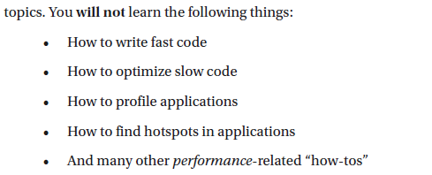
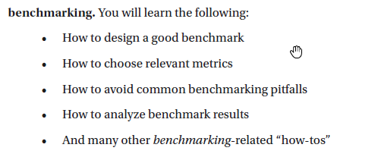
About Expectations

Slide 8
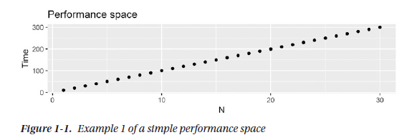
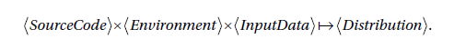
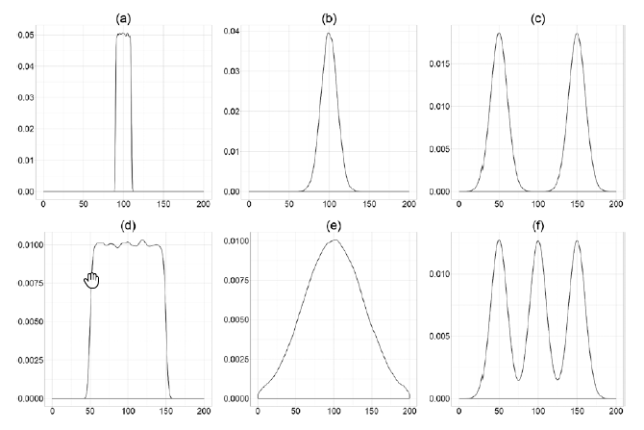
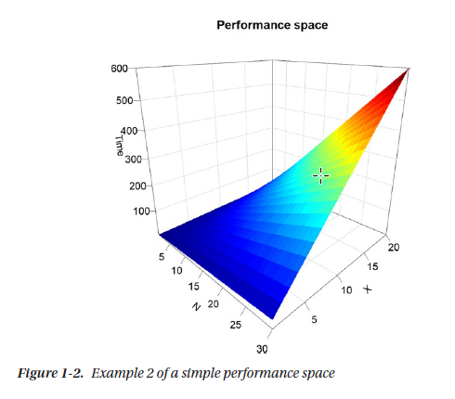
Perfomance Space

Slide 9
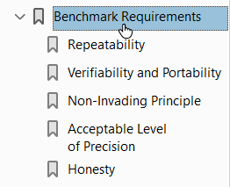
Benchmark requirements

Slide 10
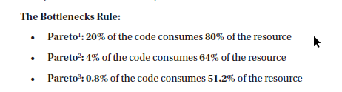
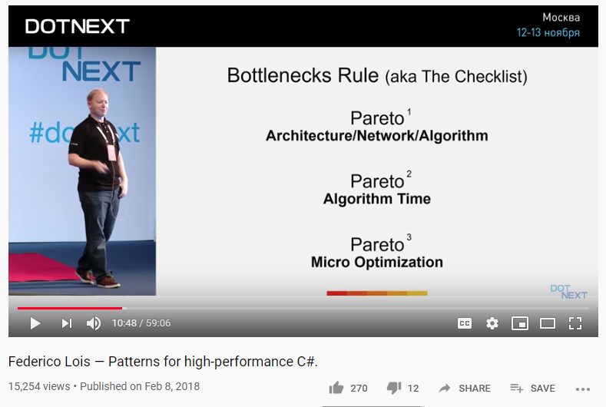
Find Your Bottleneck
https://www.youtube.com/watch?v=7GTpwgsmHgU

Slide 11
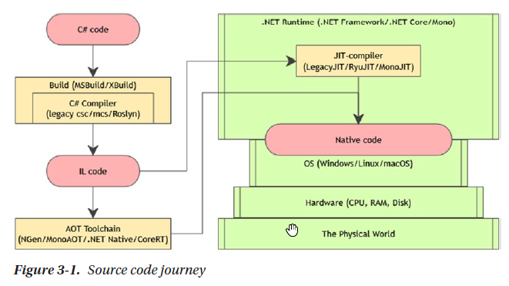
How Environment Affects Performance - Source code journey

Slide 12
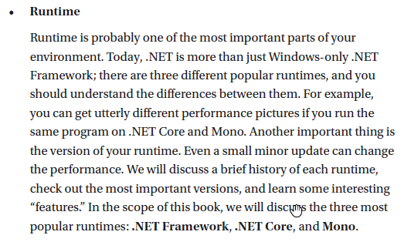
How Environment Affects Performance - Runtime

Slide 13
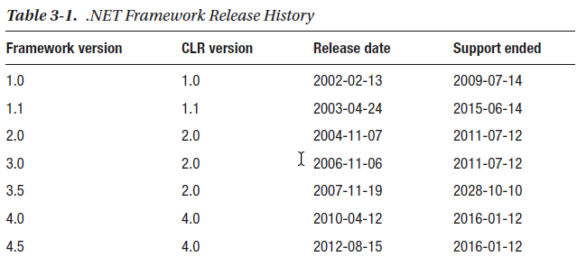
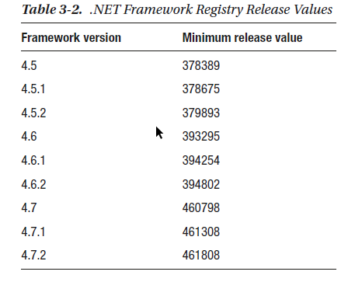
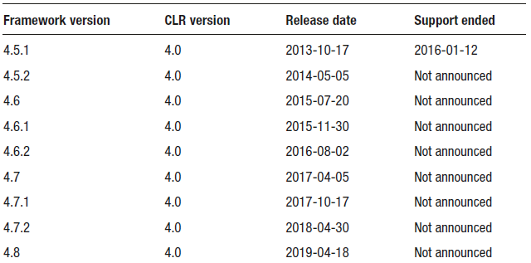
Runtimes - FULL .NET FRAMEWORK

Slide 14
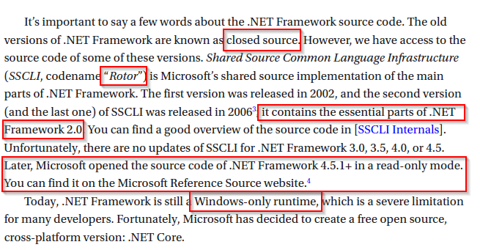
Runtimes - FULL .NET FRAMEWORK

Slide 15
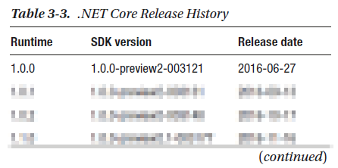
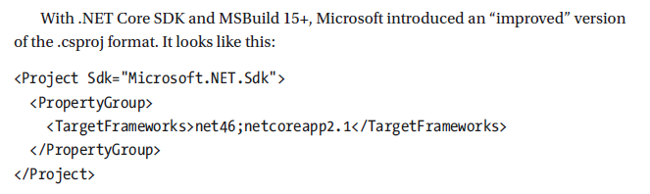
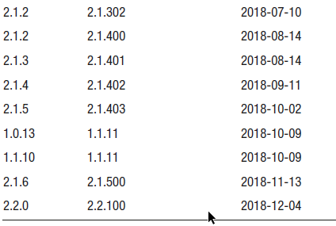
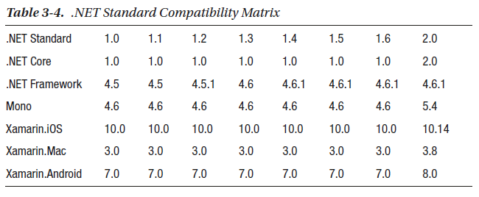
Runtimes - .net core

Slide 16
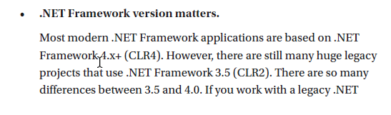
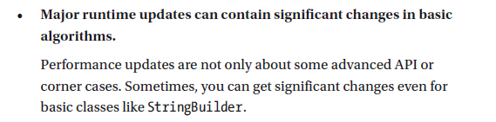
Runtimes - conclusions

Slide 17
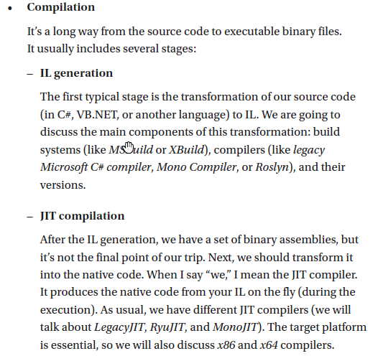
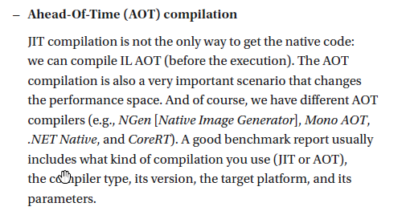
How Environment Affects Performance - Compilation

Slide 18
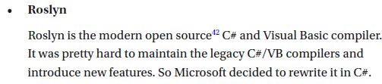
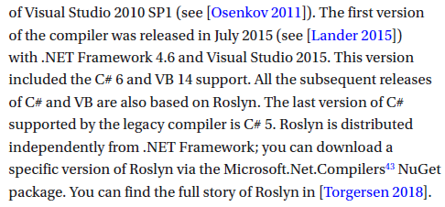
Compilation

Slide 19
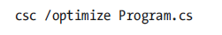
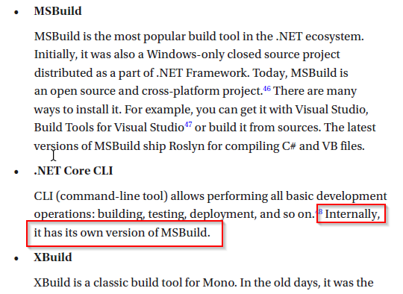
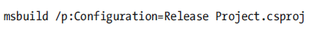
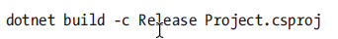
Build systems

Slide 20
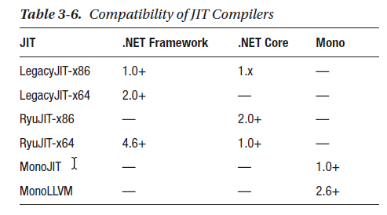
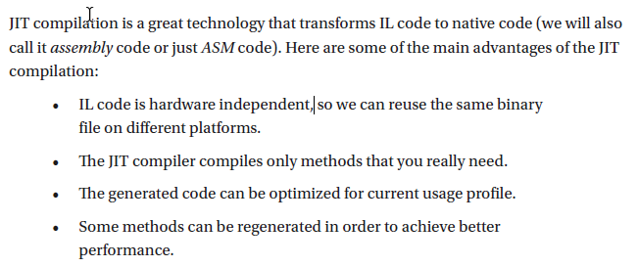
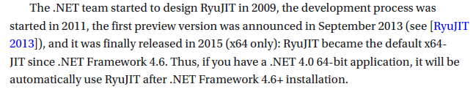
Just in time compilation

Slide 21
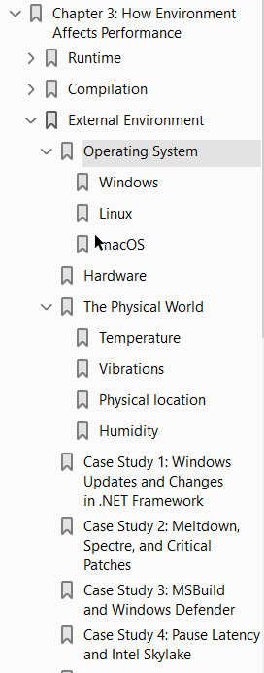
How Environment Affects Performance - External Environment

Slide 22
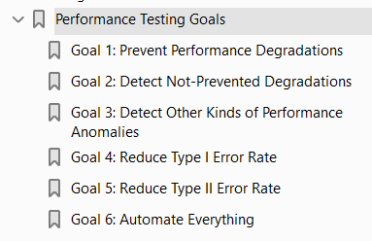
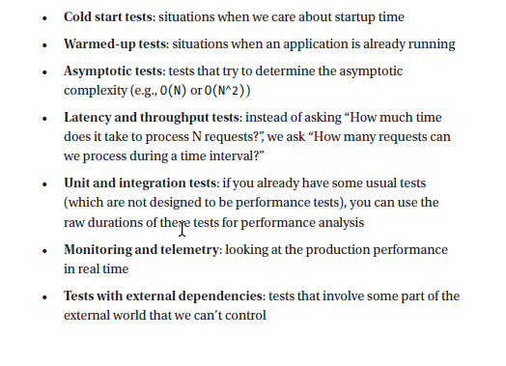
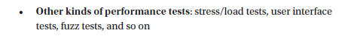
Performance Analysis and Performance Testing
Kinds of Benchmarks and Performance Tests

Slide 23
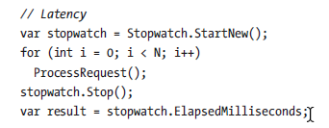
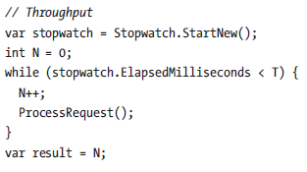
Kinds of Benchmarks and Performance Tests Latency vs Throughput

Slide 24
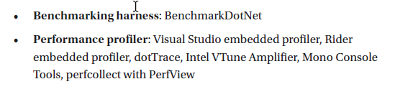
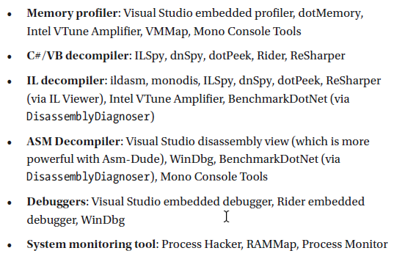
TOOLS

Slide 25
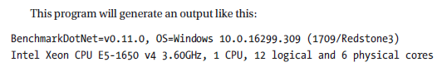


TOOLS – benchmarkdotnet
https://github.com/dotnet/benchmarkdotnet
https://benchmarkdotnet.org/

Slide 26

Tools - Performance and memory profilers in Visual Studio

Slide 27

Tools - Performance and memory profilers in Visual Studio

Slide 28

Tools - Performance and memory profilers in Visual Studio

Slide 29

Tools - Performance and memory profilers in Visual Studio

Slide 30

Tools - DOTMEMORY

Slide 31

Tools - DOTMEMORY

Slide 32

Tools - DOTMEMORY

Slide 33

Tools - DOTMEMORY

Slide 34

Tools - DOTMEMORY

Slide 35

Tools - VMMAP

